Slide 1
Sonar Qube
vikas

Slide 2
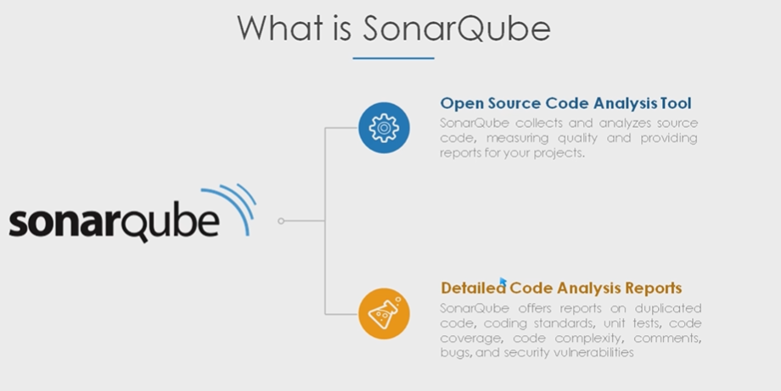
Notes:
Code quality is measured by quality review but if it’s manual it may not be effective .
Best practice about that programming language.
Code coverage [Line coverage ,branch coverage and simple coverage if you are using them all ] – quality gates
https://directdevops.blog/2019/01/30/aws-cloudformation-introuction/

Slide 3
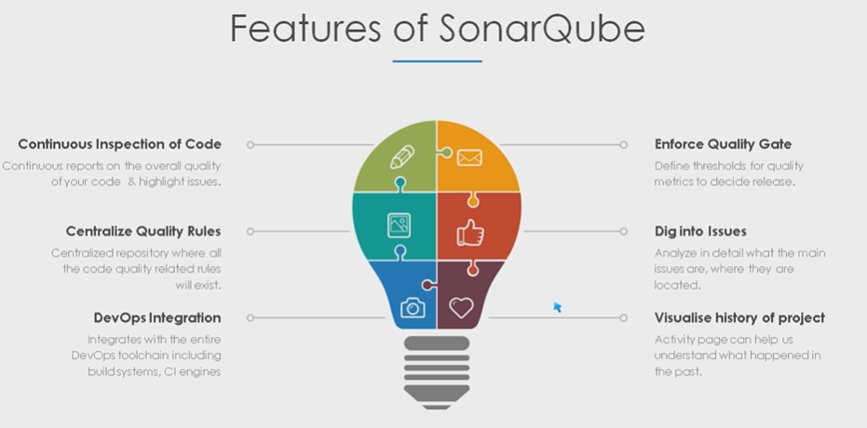

Slide 4
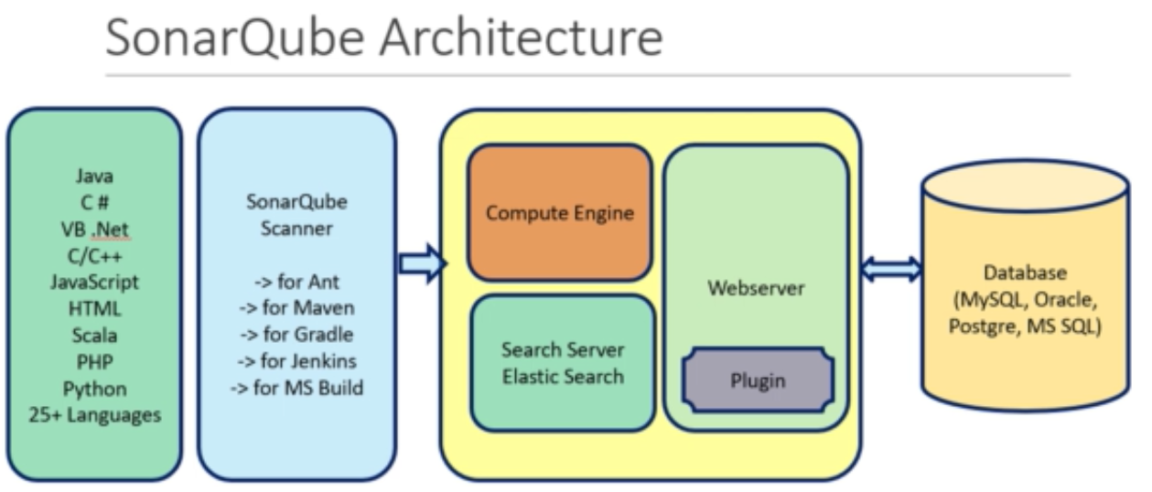
Notes:
sudo yum update -y
sudo yum install java-1.8* -y
cd /opt
sudo wget https://binaries.sonarsource.com/Distribution/sonarqube/sonarqube-6.7.7.zip
sudo unzip sonarqube-6.7.7.zip
sudo chown -R ec2-user:ec2-user sonarqube-6.7.7
cd sonarqube-6.7.7
cd bin
cd linux-x86-64
./sonar.sh start
./sonar.sh status

Slide 5
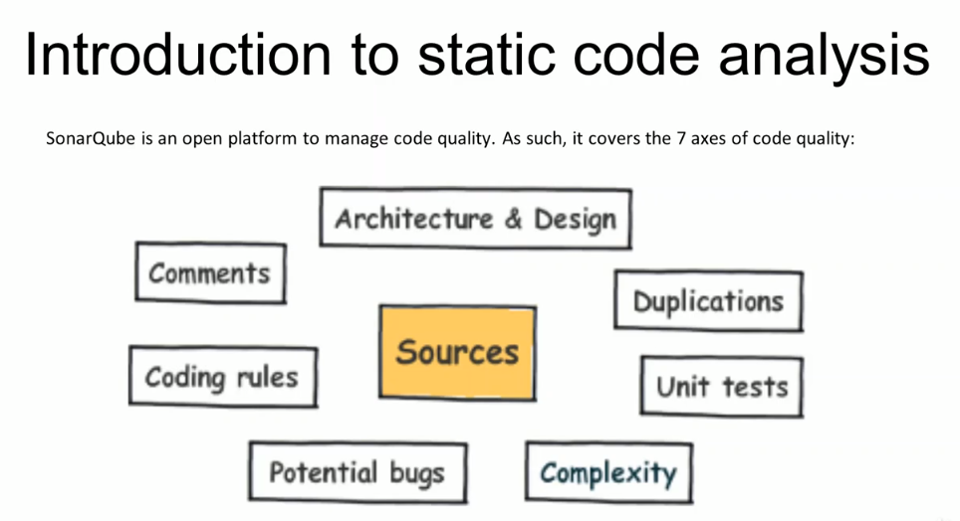
Notes:
docker run -d --restart=always --name sonarqube -p 9000:9000 -p 9092:9092 sonarqube:lts
docker ps | grep sonarqube
docker logs -f sonarqube
sonar.projectKey=devops:course
sonar.projectName=Web-app sample
sonar.java.binaries=.
sonar.projectversion=1.0
sonar.sources=.

Slide 6
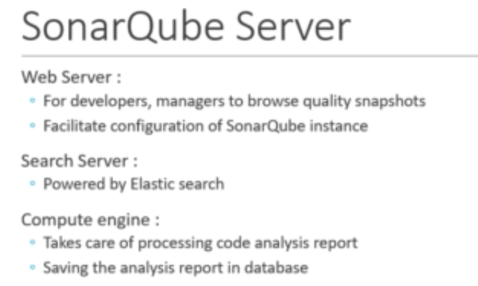
Notes:
Parameters of Quality :
Potential bug
Coding rules
Tests
Duplication
Comments
Architecture & Design
Complexity

